Slide 1



Real-Time Air Quality Monitoring Dashboard
Presented By,
811722104088-MAYURI DEVI S 811722104092-MONIKA M
811722104114-PRIYADHARSHINI A
Guided By,
Mrs. K Valli Priyadharshini, M.E., (Ph.D.,)
DD/MM/YYYY

Slide 2
ABSTRACT
Real-time air quality data from IoT sensors.
Live dashboard with charts and maps.
Alerts for unsafe pollution levels.
Historical data tracking and analysis.
Accessible on all devices for users.
DD/MM/YYYY

Slide 3
OBJECTIVE
1. Provide Immediate Air Quality Data: Offer up-to-date information on pollutant levels to inform public health decisions and raise awareness.
2. Identify Pollution Sources: Enable detection of pollution patterns and sources, facilitating targeted mitigation strategies.
3.Enhance Environmental Policies: Supply accurate data to support the development and enforcement of effective environmental regulations.
DD/MM/YYYY

Slide 4
LITERATURE SURVEY
S.No. | Paper Title | Year | Remark
1 | Advances in Air Quality Monitoring: A Comprehensive Review of Algorithms for Imaging and Sensing Technologies | 2024 | This review highlights recent advancements in algorithms used for air quality monitoring through imaging and sensing technologies.
2 | Community-empowered air quality monitoring system | 2023 | This work focuses on community-driven air quality monitoring systems that leverage low-cost sensors, citizen participation, and open data platforms.
3 | GASDUINO: Wireless Air Quality Monitoring System Using IoT | 2020 | Low-cost, portable IoT system; suitable for smart city and educational use.
DD/MM/YYYY

Slide 5
LITERATURE SURVEY
S.No. | Paper Title | Year | Remark
4 | An Intelligent Edge-Deployable Indoor Air Quality Monitoring and Activity Recognition Approach | 2023 | Smart home solution using deep learning for air quality and human activity monitoring.
5 | Toward SATVAM: An IoT Network for Air Quality Monitoring | 2018 | Early and scalable approach for AQ monitoring in developing regions, especially India.
6 | AirSPEC: An IoT-Empowered Air Quality Monitoring System Integrated with a Machine Learning Framework | 2021 | Combines real-time monitoring with prediction; strong ML integration.
DD/MM/YYYY

Slide 6
LITERATURE SURVEY
S.No. | Paper Title | Year | Remark
7 | Advanced Air Pollution Monitoring System with Real-Time Data Acquisition | 2023 | Simple and cost-effective; ideal for academic and student projects.
8 | Development of an IoT-Based Indoor Air Quality Monitoring Platform | 2020 | Professional platform for mass deployment; cloud-integrated system.
9 | An IoT System for Air Pollution Monitoring with Safe Data Transmission | 2024 | Focuses on data security in AQ systems; essential for privacy-sensitive environments.
DD/MM/YYYY

Slide 7
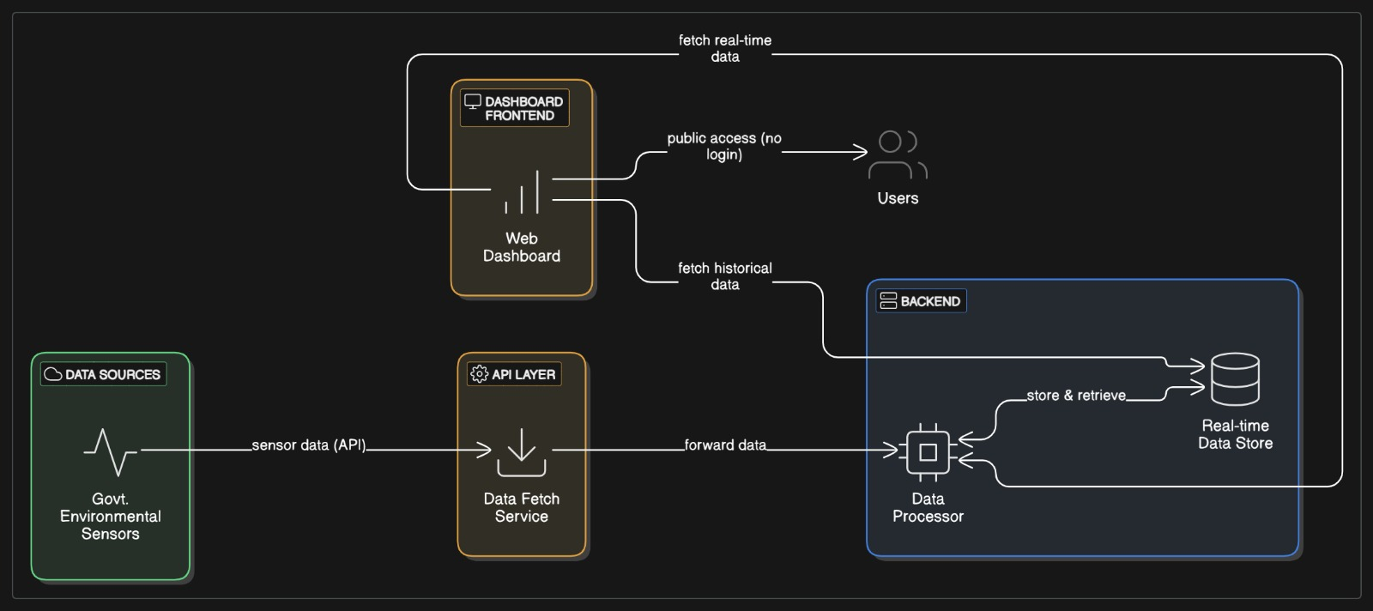
EXISTING SYSTEM
DD/MM/YYYY

Slide 8
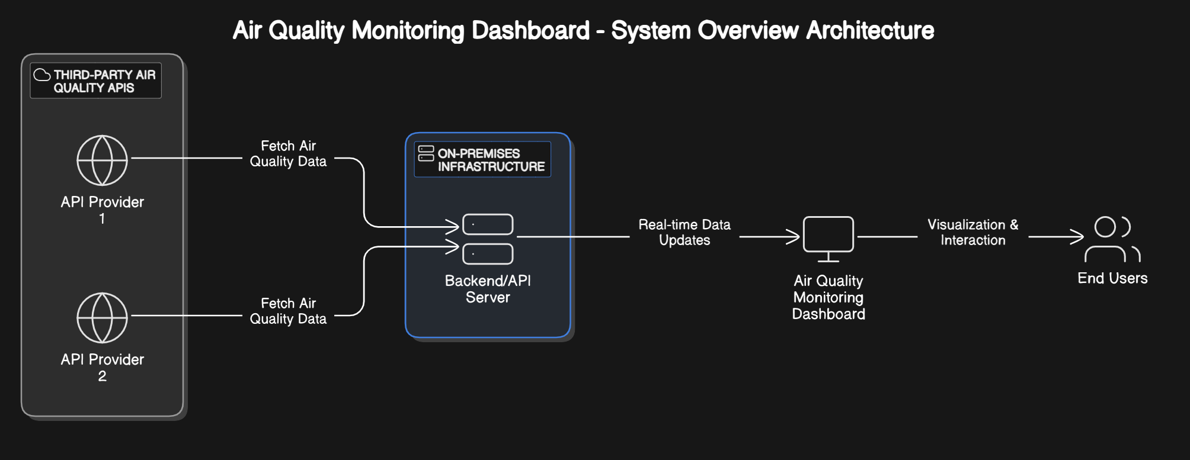
PROPOSED SYSTEM
DD/MM/YYYY

Slide 9
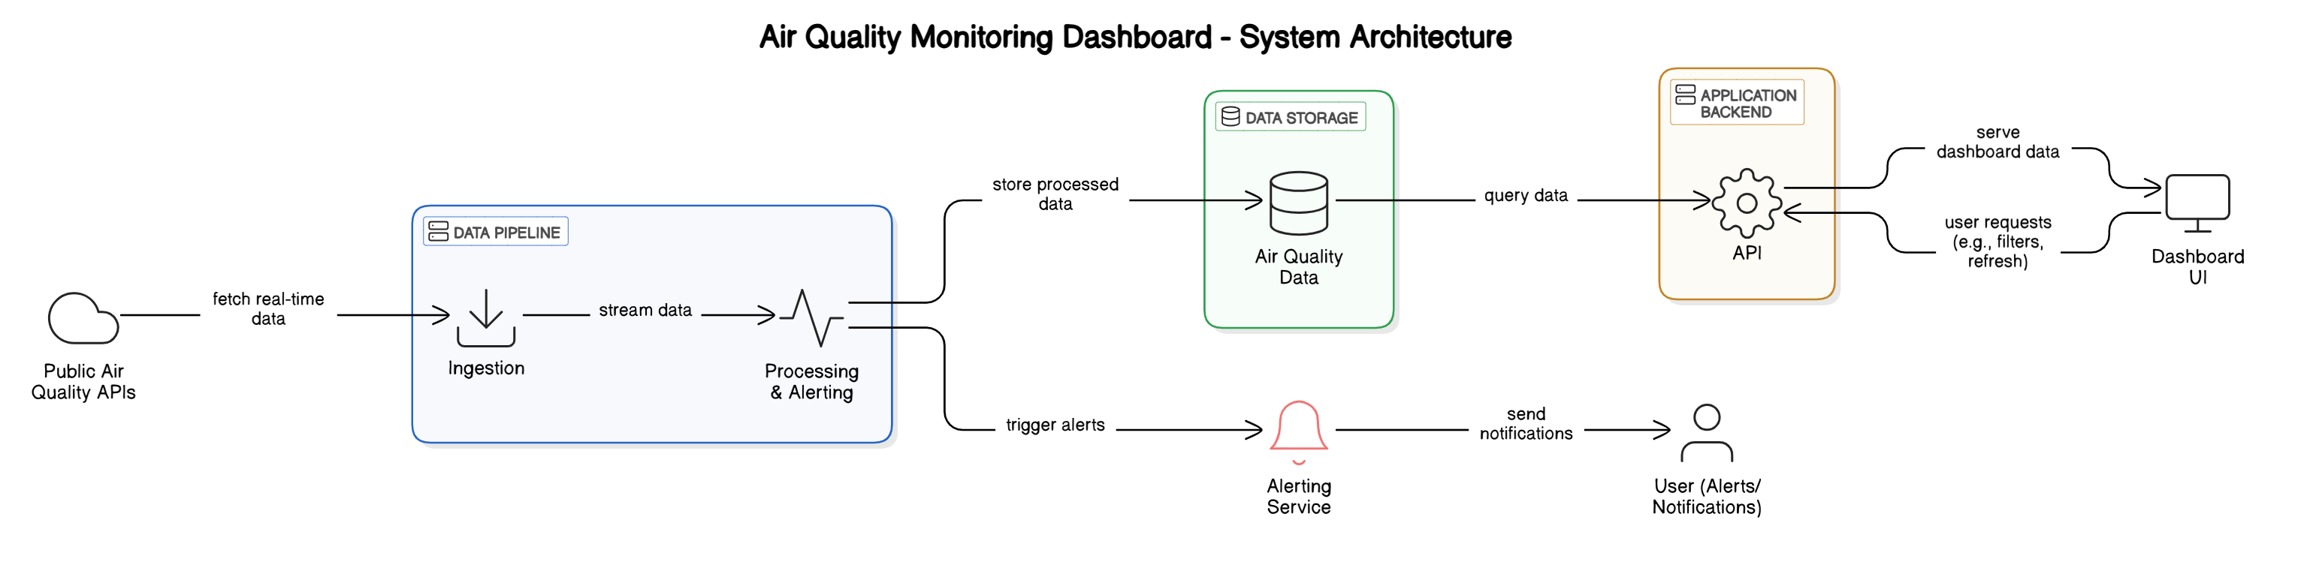
SYSTEM ARCHITECTURE
DD/MM/YYYY

Slide 10
MODULE 1: DATA COLLECTION MODULE
Fetches real-time air quality data from APIs
Ensures accurate and up-to-date pollution monitoring.
Uses API calls and sensor integrations to collect PM2.5, PM10, NO2, CO, and O3 data.
DD/MM/YYYY

Slide 11
MODULE 2 : DATA PROCESSING & STORAGE MODULE
Cleans and organizes collected data.
Stores data in a MongoDB/PostgreSQL database.
Applies basic machine learning models for air quality prediction.
DD/MM/YYYY

Slide 12
MODULE 3 : VISUALIZATION & DASHBOARD MODULE
Displays AQI data using charts, graphs, and maps.
Implements a color-coded AQI scale for easy interpretation.
Uses React.js or Vue.js for an interactive UI.
DD/MM/YYYY

Slide 13
MODULE 4 : MANUAL LOCATION INPUT
Allows user to manually input a location.(e.g., “Trichy”)
Fetches AQI and pollutant levels using OpenWeatherMap API.
Based on the input , it fetches and display air quality data.
DD/MM/YYYY

Slide 14
MODULE 5: USER LOCATION & PERSONALIZATION MODULE
Uses GPS-based location tracking to fetch air quality data for a user’s location.
Allows users to save locations for quick access.
Provides historical air quality trends for specific locations.
.
DD/MM/YYYY

Slide 15
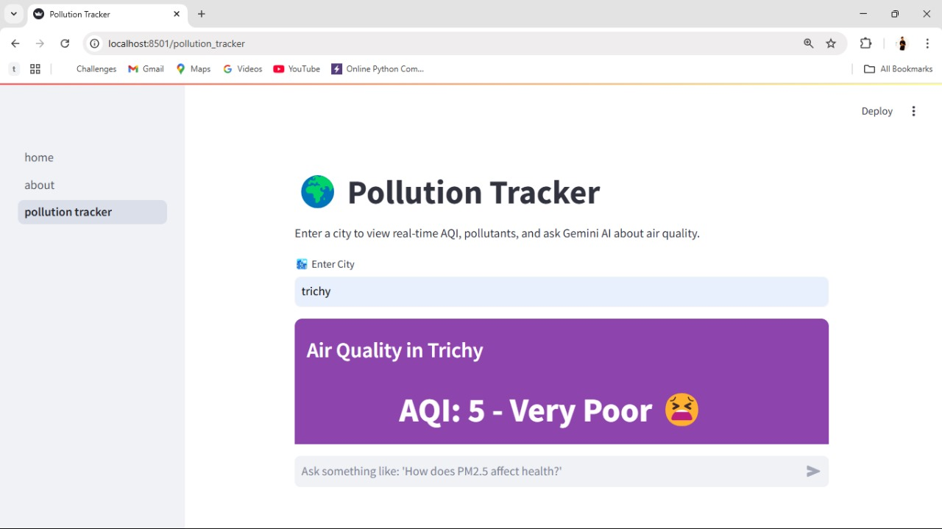
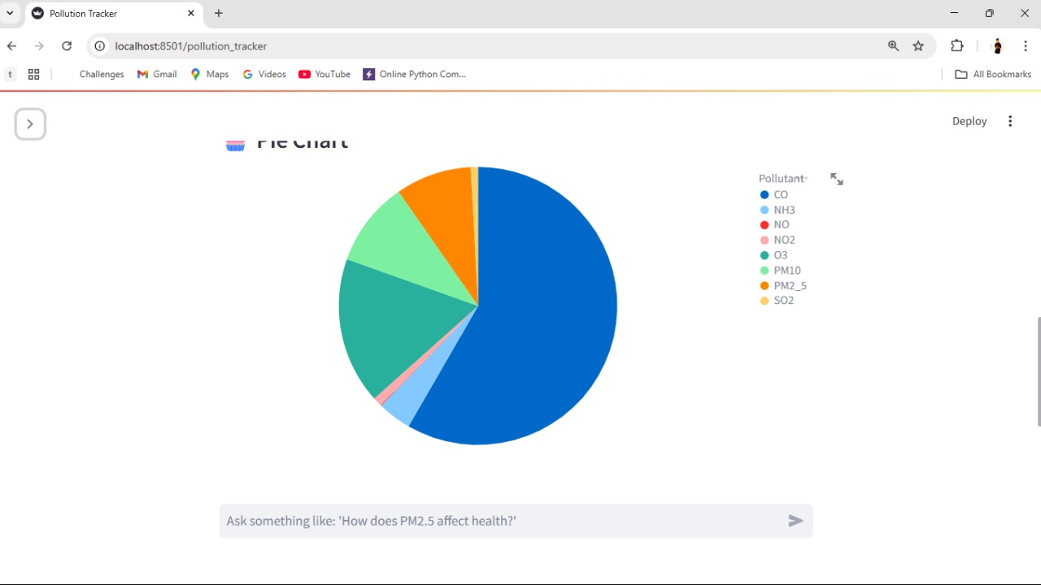
OUTPUT
DD/MM/YYYY

Slide 16
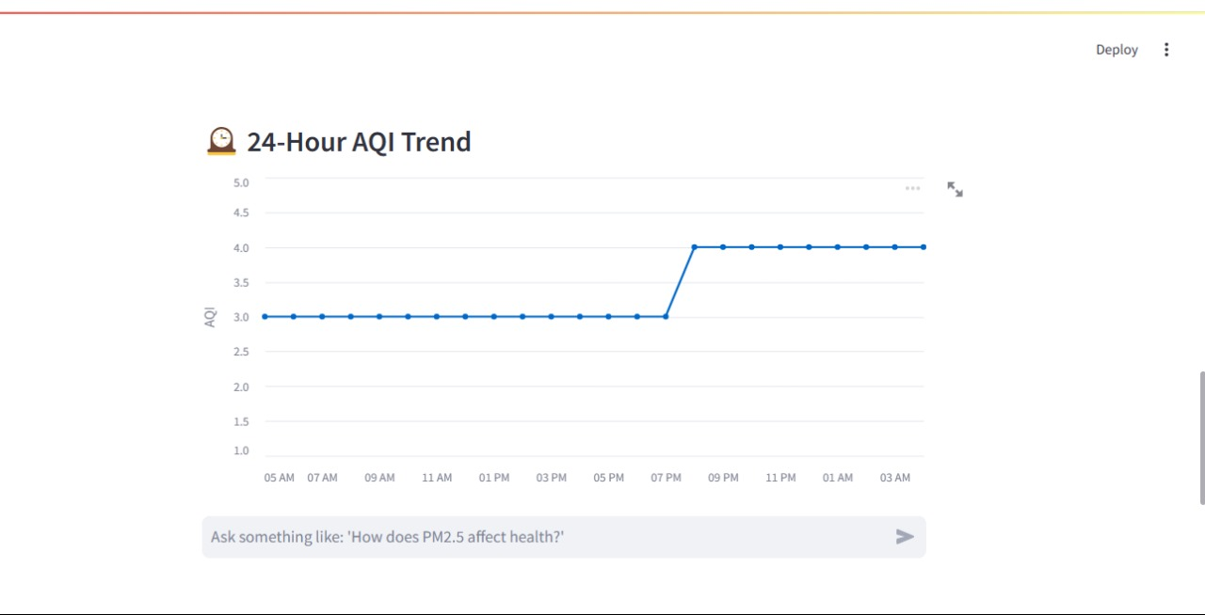
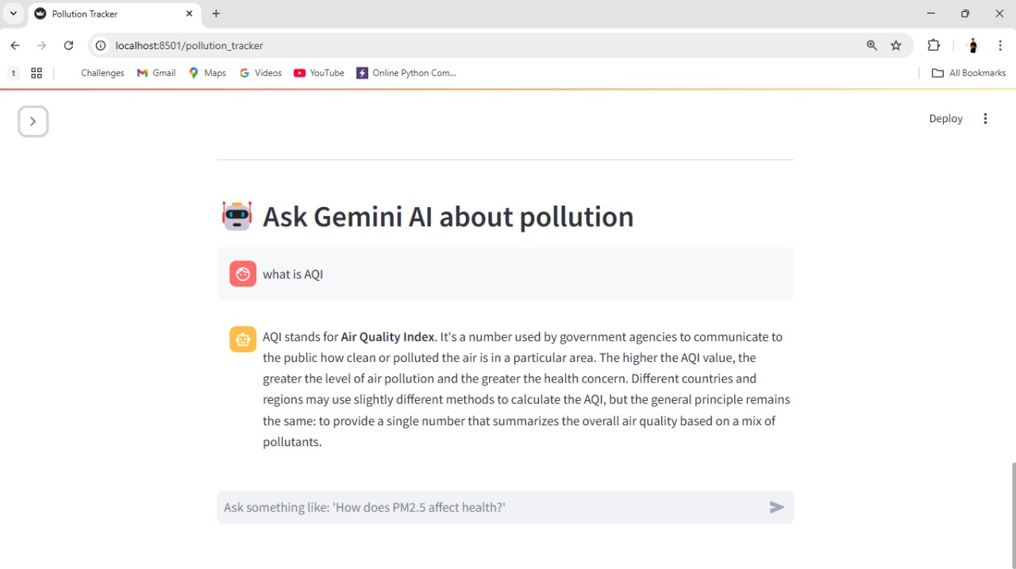
OUTPUT
DD/MM/YYYY

Slide 17
CONCLUSION & FUTURE ENHANCEMENT
1.Mobile App Version
Build a companion mobile app using React Native or Flutter.
2.Geolocation Support
Automatically detect user’s location via browser and fetch local AQI data.
3. Social Sharing & Community Reporting
Let users share air quality updates or photos from their region.
4.Health Recommendations
Display personalized health advice based on AQI levels (e.g., “Wear a mask”, “Avoid outdoor exercise”).
DD/MM/YYYY

Slide 18
REFERENCES
1.The paper "Air Quality Monitoring System Based on IoT using Raspberry Pi" by Somansh Kumar and Ashish Jasuja was published in the year 2017.
2.The paper “Visualization Platform for Multi-Scale Air Pollution Monitoring and Forecast” by H. D. Nguyen, T. H. Le, H. A. D. Nguyen, X. Barthelemy, T. T. Nguyen, Q. P. Ha, N. Jiang, H. Duc, M. Azzi, and M. Riley was published in the year 2024.
3.The paper“A dashboard system for monitoring air pollution in surabaya based on PM2.5” by Valentinus Roby Hananto and I Gusti Ngurash Alit Widana Putra was published in the year 2018
DD/MM/YYYY

Slide 19

DD/MM/YYYY

